Slide 1

Predicting Student Grades: An Analytics Approach
Leveraging Machine Learning to Enhance Education Outcomes

Slide 2

The Challenge: Early Identification of At-Risk Students
In education, proactive intervention is key to student success. Our goal is to develop a robust predictive model that estimates students' final grades early in the academic cycle.
Problem Statement
Estimate students' final grades (G3) using various factors to help educators identify and support at-risk students before it's too late.
Key Data Points
Demographic factors (e.g., age, sex, address)
Social factors (e.g., family size, parent's job, home support)
Academic factors (e.g., study time, attendance, prior grades)

Slide 3
Methodology: Building the Predictive Model
Our approach combines data loading, preprocessing, exploratory data analysis, and the training of multiple machine learning algorithms to find the most accurate predictor.
01
02
03
Data Acquisition & Loading
Data Preprocessing
Exploratory Data Analysis (EDA)
Utilize the student performance dataset from Kaggle, ensuring proper file parsing and handling potential errors.
Clean and transform the data, including encoding categorical variables and managing any missing values. This ensures data readiness for model training.
Gain insights into the dataset's characteristics, including grade distribution, feature correlations, and the impact of key factors like study time and past failures.
04
05
Model Training & Evaluation
Feature Importance & Risk Assessment
Implement and train various Scikit-learn regression models (Linear, Ridge, Lasso, Random Forest, Gradient Boosting, SVR). Evaluate performance using metrics like RMSE, MAE, and R² score.
Analyze the significance of each feature and use the best-performing model to categorize students into risk levels (High, Moderate, Safe).

Slide 4
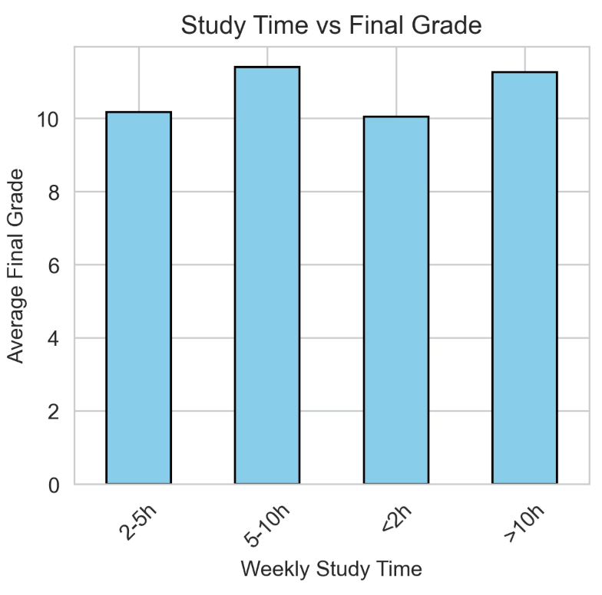
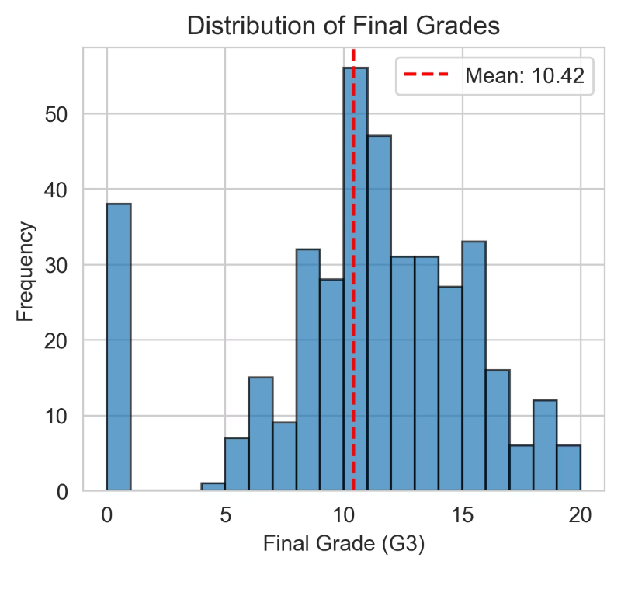
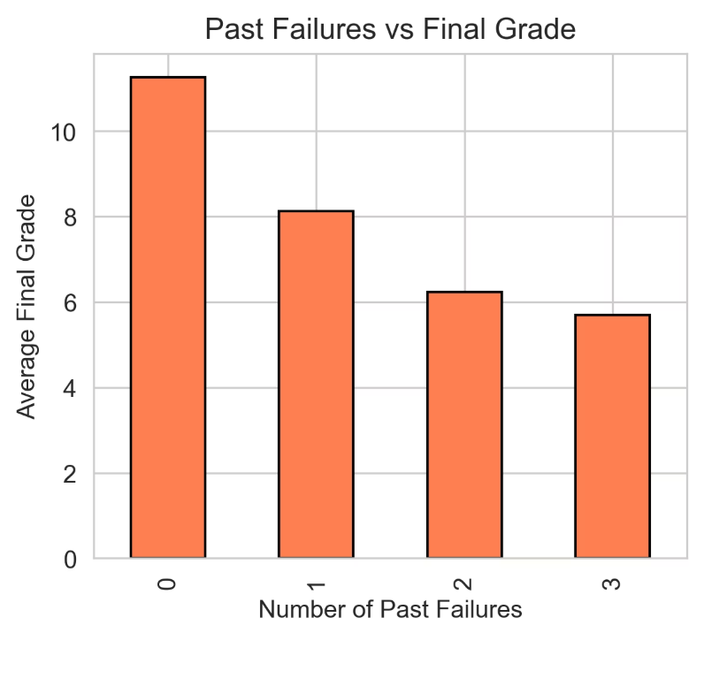
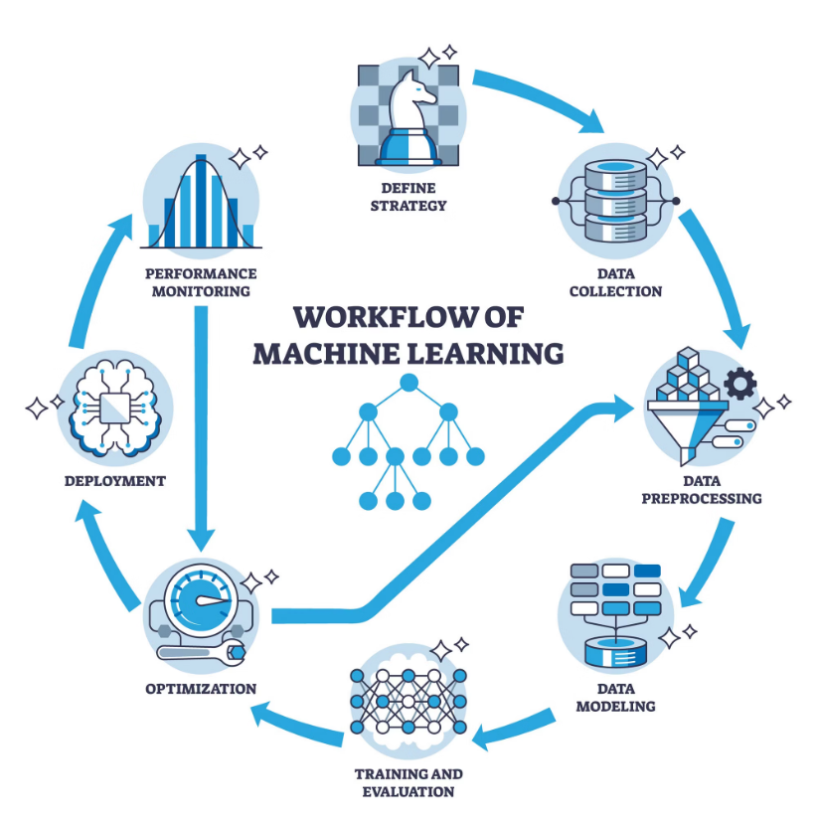
Data Insights: Unpacking Student Performance Factors
Study Time vs. Final Grade
Past Failures vs. Final Grade
A strong inverse relationship exists: an increase in prior academic failures correlates with a decrease in average final grades.
Students dedicating more weekly study hours tend to achieve
Higher final grades, with a clear positive correlation observed
across categories
Final Grade Distribution
Work Flow Diagram
The distribution of final grades often follows a bell-shaped curve, with a concentration around the mean. This visualization helps us understand the overall academic landscape.
This showing how the aiml algorithm works to predict the student grade

Slide 5
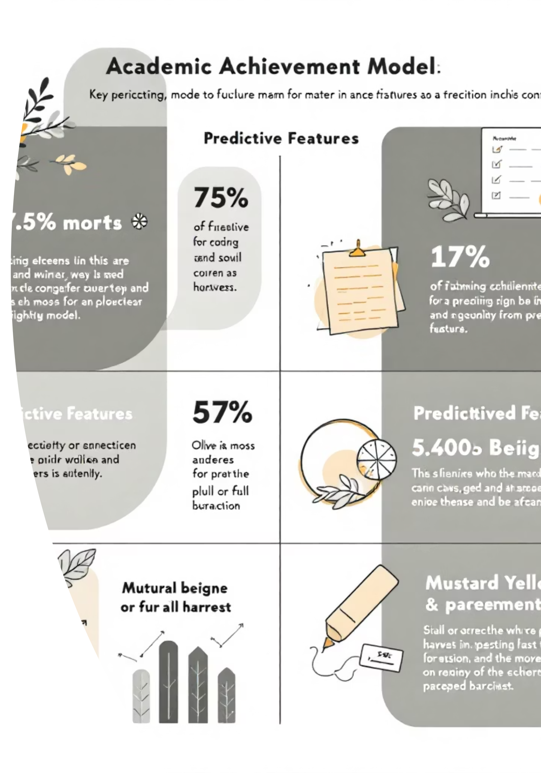



Model Performance & Key Predictors
After training and evaluating various models, we identify the most effective one and understand which features drive grade predictions.
Best Model: Gradient Boosting
Key Metrics
Gradient Boosting Regressor consistently outperforms other models, achieving the lowest RMSE and highest R² score.
R² Score: 0.8123 (explains 81.23% of variance)
RMSE: 1.25 points (average prediction error)
Top Features
Previous grades (G1, G2)
Study time
Absences
Family support

Slide 6
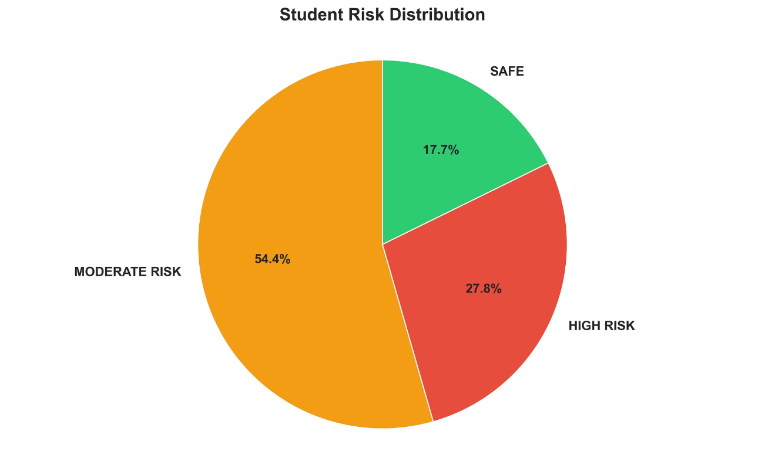




Impact & Future Directions
This predictive model offers actionable insights for educators, enabling targeted interventions and fostering student success.
Key Takeaways
Early identification of at-risk students.
Improved resource allocation for student support.
Insights into factors influencing academic success.
Next Steps
Integrate the model into existing educational platforms.
Continuously refine the model with new data and features.
Develop personalized intervention strategies based on risk levels.
Student Risk Distribution
The model categorizes students into risk groups, allowing for tailored support. High-risk students need immediate attention, while moderate-risk students can benefit from extra resources.
High Risk
Immediate intervention
Moderate Risk
Extra support recommended
Safe
Monitor to maintain performance

